Slide 1
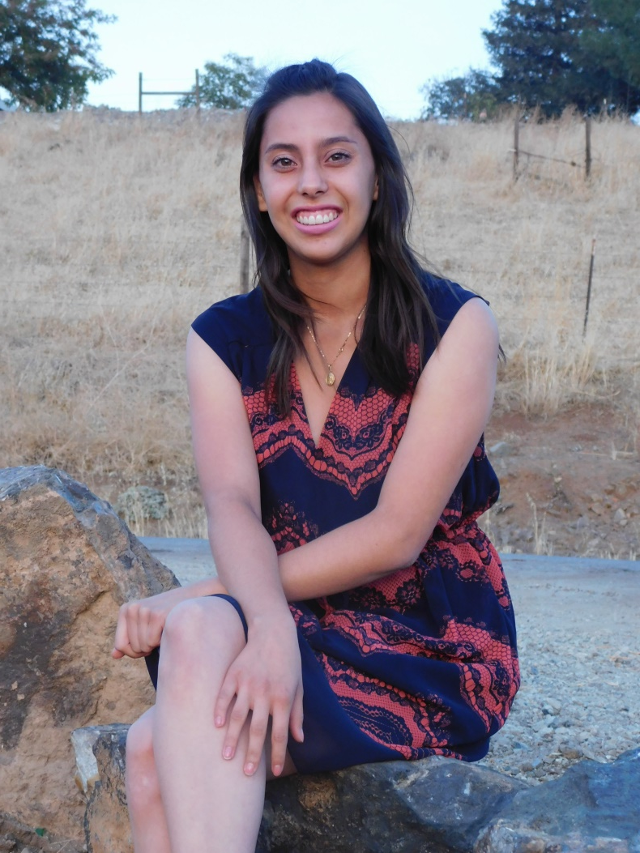
Hilda Gomez

Slide 2
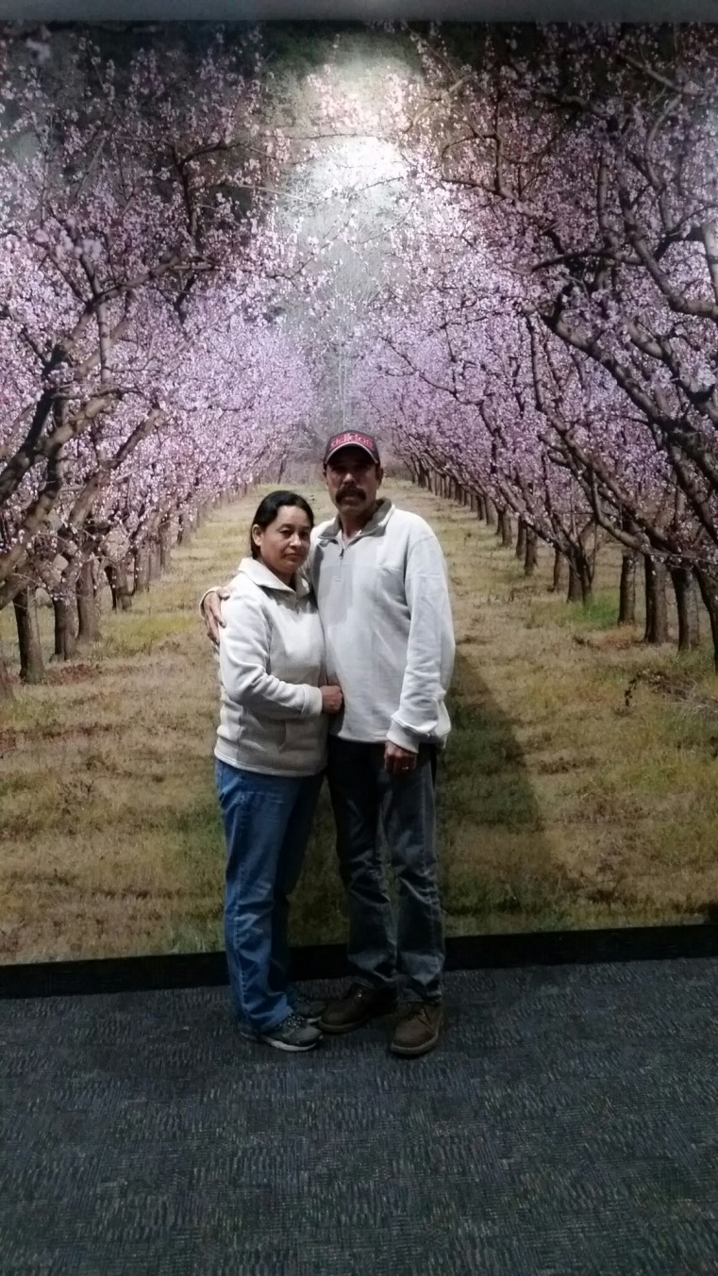
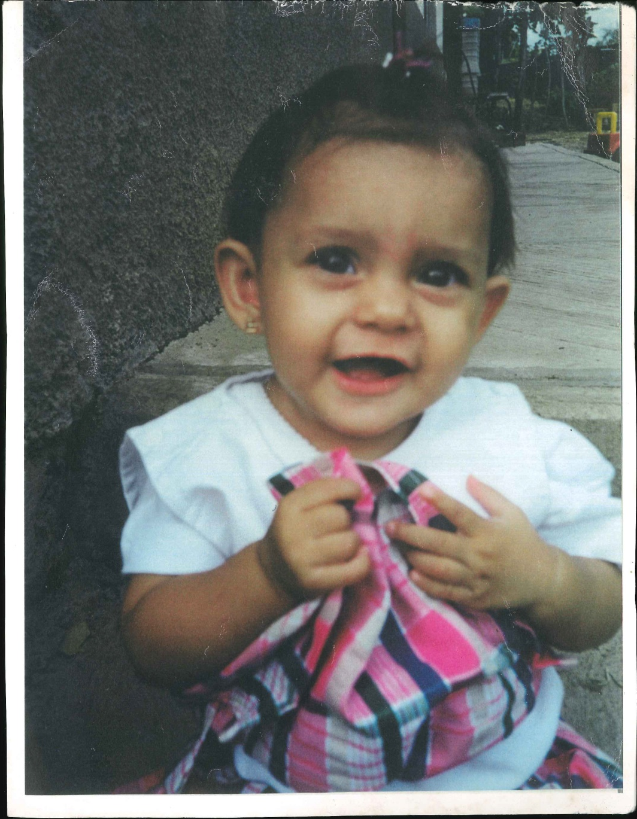
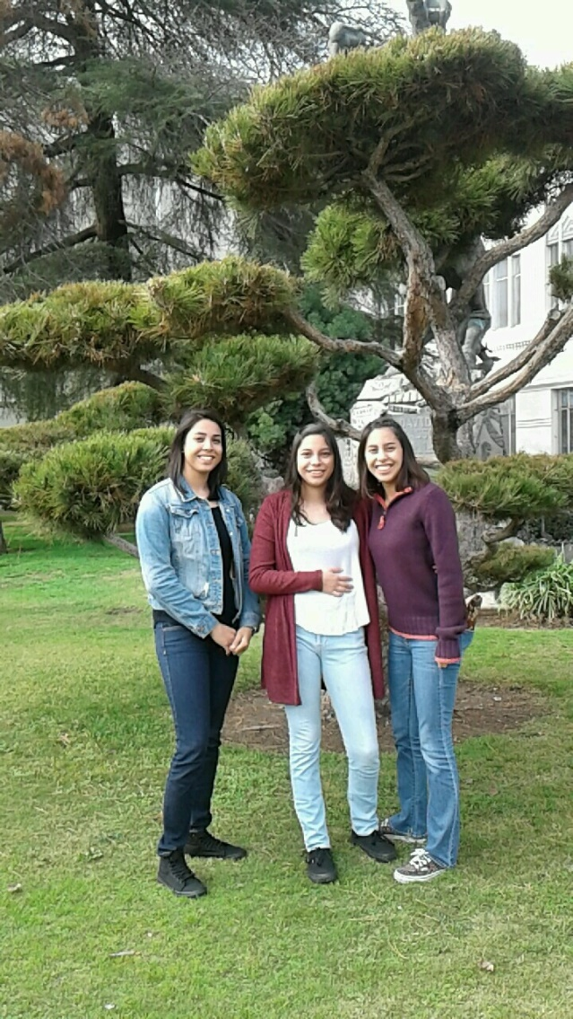
Sobre Mi
Nací el 22 de Diciembre del año 1998
Vengo de una familia de inmigrantes
Magdalena Jalisco, México
Somos 5 incluyéndome a mi

Slide 3
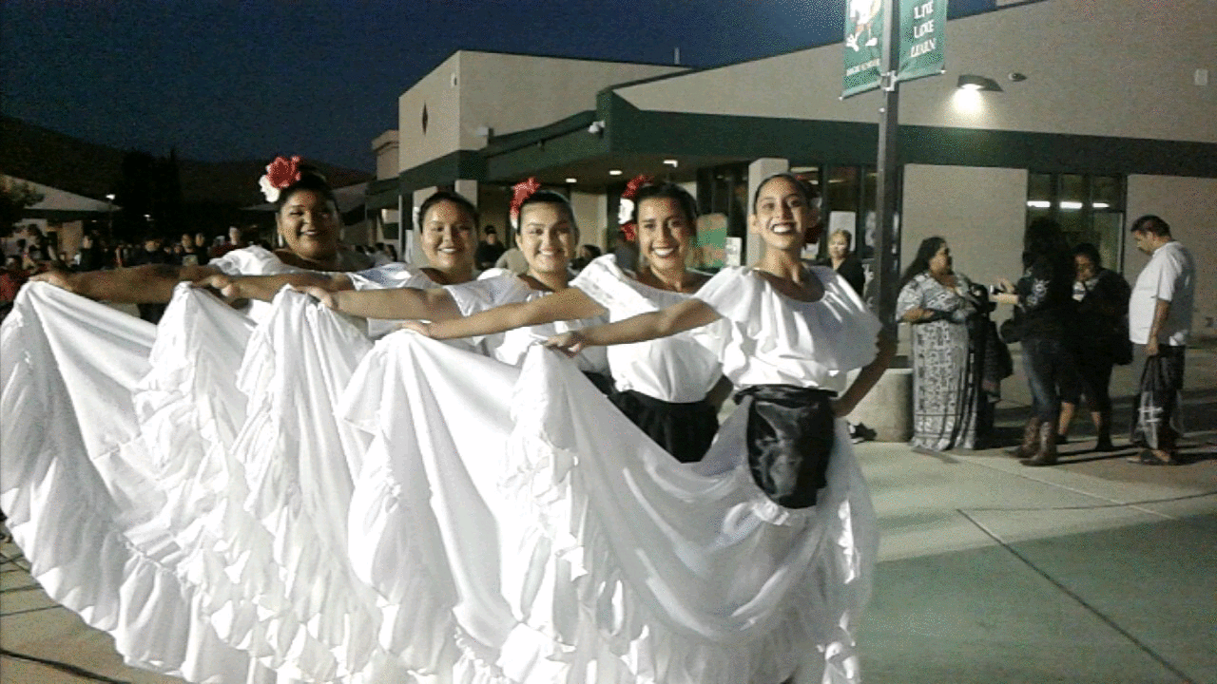
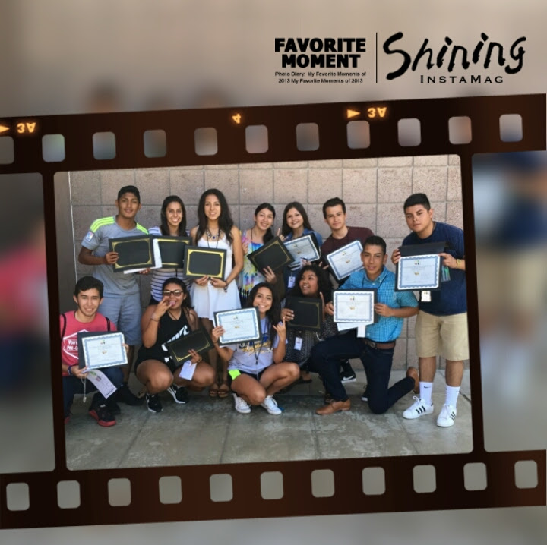
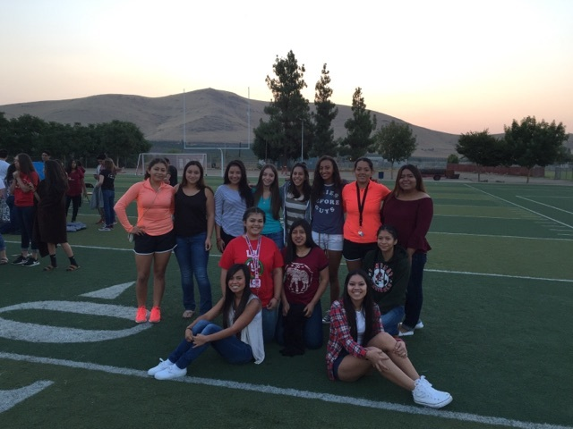
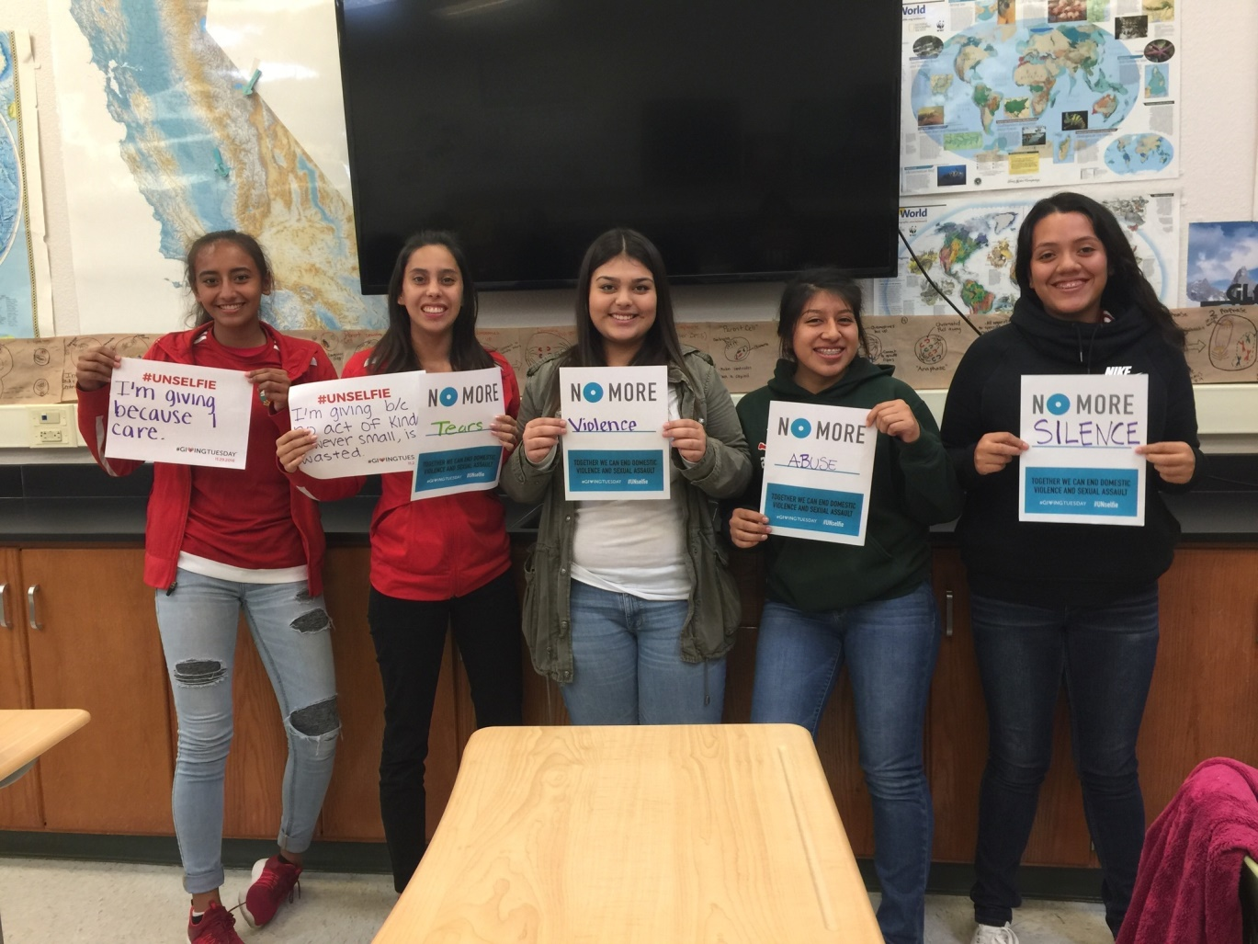
Mi experiencia en la secundaria
E participado en diferentes organizaciones:
REAP
My Voice
ASL
Programa Migrante
El sistema PBS a sido un desafío
Tener la mentalidad de aprender nosotros mismos

Slide 4
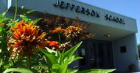
Observación profesional
Yo escogí a un maestro de Primaria
Se conecta con mi interés de ser una profesora de universidad o colegio
Hay mucho trabajo que necesita ser calificado
Tenido la oportunidad de ensenar a un grupo
Es un trabajo que si me miro haciendo en el futuro

Slide 5
Pathway
French
It interest me to learn a new language
Relates to my major in being able teach in a foreign language
It taught me a new culture

Slide 6
Post-High School Plans
I have not decided where I would like to go after High School
Close to home
I have applied to:
CSU Bakersfield, CSU Fresno, CSU Stanislaus, CSU East Bay
Porterville College, College of the Sequoias
Major is Applied Mathematics
Credentials in single subject teaching
Minor is Business Administration
Really don’t have Financial Support from my family
Short term goal is to graduate from High School

Slide 7
Leaving High School
A great experience
More independent learner
I have a potential in Math
From PBS I am taking:
learning on my own
Determination

